Slide 1

Parents and Carers · Secondary · Session 5
Partnership with the School
Notes:
SUGGESTED TIME: 1 min · 1:30 - 1:31
PURPOSE
Open the partnership session and connect it to what families have noticed at home.
WHAT TO DO
1. Name the shift from what happens at home to how home and school can understand and act together.
2. Ask participants to keep in mind one thing they noticed at home in Session 4 that school might need to know.
3. Keep your young person at the centre of the conversation, and as a partner in it.
4. Acknowledge that participants will bring very different school experiences, some helpful and some difficult.
5. Remind the room that sharing is voluntary, and that schools and staff are not named in the whole group.
KEY MESSAGES
• Partnership is part of understanding and supporting your young person from the start.
• Your young person, your family and the school may each hold different parts of the picture.
KEEP IN MIND
• Some families are in a very hard place with their school right now. Acknowledge this without inviting detailed accounts in the whole group.
THREAD
Picks up what participants noticed at home in Session 4 (Home and Community).

Slide 2
Working in partnership
Family
School staff
What is the goal of these intersecting partnerships?
Every partner brings different knowledge and a different relationship with your young person.
Your young person is at the centre of every partnership.
Young person
Support staff
Notes:
SUGGESTED TIME: 2 min · 1:31 - 1:33
PURPOSE
Show where the partnerships around a young person intersect, with the young person at the centre of every one.
WHAT TO DO
1. Introduce the diagram: family, school staff and support staff, with your young person at the centre.
2. Explain that every partner brings different knowledge and a different relationship with your young person and with each other.
3. Ask the group: What is the goal of these intersecting partnerships?
4. Steer the discussion so the point is made that the young person is at the centre of every partnership.
5. Ask who else might be part of the picture for their young person, such as a therapist, a tutor, a grandparent or an employer, and how the young person's own views can be included.
YOU MIGHT SAY
What is the goal of these intersecting partnerships?
KEY MESSAGES
• Positive partnership keeps your young person at the centre.
• No single person holds the complete picture.
• Parents and carers bring knowledge of their young person that no one else has.
KEEP IN MIND
• Use the diagram as a discussion prompt rather than a complete definition.
THREAD
Draws on 'You are the expert on your young person' from Session 1.

Slide 3

Building a home-school partnership
Parents and families are the first and continuing educators of their children
Learning is lifelong and occurs in multiple settings
Partnerships, schools and school communities flourish when the diversity and strengths of families are valued and leveraged
Community engagement expands responsibility and resources
Partnerships grow from mutual trust, respect and responsibility
Partnerships need committed, collaborative and creative leadership
Family-School Partnerships Framework, Department of Education, 2020
Notes:
SUGGESTED TIME: 2 min · 1:33 - 1:35
PURPOSE
Use the Family-School Partnerships Framework principles to show what families can expect a partnership to look like.
WHAT TO DO
1. Walk through the six Framework principles briefly.
2. Draw attention to the first principle: parents and families are the first and continuing educators of their children.
3. Position family knowledge and school knowledge as different, useful perspectives.
4. Name what partnership looks like in practice: a shared purpose, respectful listening, your young person's voice, clear information, and agreed next steps with follow-up.
KEY MESSAGES
• Your knowledge of your young person and the school's knowledge are both needed from the beginning.
• Listening, clarity and shared next steps are things you can look for in practice.
KEEP IN MIND
• Avoid implying that agreement is needed before listening or respect are possible.
RESOURCES
Family-School Partnerships Framework - Department of Education, Australian Government - https://www.education.gov.au/supporting-family-school-community-partnerships-learning/family-school-partnerships/family-school-partnerships-framework

Slide 4
What is effective collaboration?
Shared goals
Seeing other perspectives
Shared values
Invite curiosity: How could we work together so school goes well for my young person?
Mutual trust and respect
Centring your young person's voice
Consult on decision-making
Assume good intent
Notes:
SUGGESTED TIME: 3 min · 1:35 - 1:38
PURPOSE
Name the collaboration principles that strong partnerships share, whoever is at the table.
WHAT TO DO
1. Introduce why collaboration matters: in secondary school there are many teachers and staff, and many points where home and school need to work together.
2. Explain that the key collaboration principles are the same across every partnership around your young person.
3. Ask the group: What are some of the key principles for effective collaboration?
4. Build the discussion to cover: shared goals, shared values, mutual trust and respect, consulting on decision-making, seeing other perspectives, inviting curiosity, centring your young person's voice and assuming good intent.
5. Once the room has contributed, point to the list on the slide and pick up anything not yet mentioned.
YOU MIGHT SAY
What are some of the key principles for effective collaboration?
How could we work together so school goes well for my young person?
KEY MESSAGES
• The same principles apply in every partnership around your young person.
• Starting from what you both want for your young person, and staying curious, can help even when a conversation is hard.
KEEP IN MIND
• 'Assume good intent' can be hard to hear for families who have had poor experiences. Acknowledge that trust is built on both sides and is not the family's job alone. Where trust has been damaged, it may need rebuilding over time, and starting from what you both want for your young person can be an easier first step.
BACKGROUND
This slide was added by the team because it works well with all parties and helps shift perspectives.

Slide 5

Power dynamics
Power can sit in:
Young person
Socio-economic status
Historical / cultural experiences of education
Speaking English vs speaking a language other than English
How school works: teaching approaches and school systems
Home
School
Perception of the importance / experience of school
Notes:
SUGGESTED TIME: 2 min · 1:38 - 1:40
PURPOSE
Help participants notice how agendas, language, authority and decision-making can shape a school conversation.
WHAT TO DO
1. Introduce the seesaw: school, home and your young person.
2. Name where power can sit: socio-economic status, historical and cultural experiences of education, speaking English or another language, how school works (teaching approaches and school systems), and how important school is seen to be.
3. Ask the power questions below to look at how meetings work, not to blame anyone.
4. Invite participants to think about where school language, timing or process has made it harder for them to take part.
YOU MIGHT SAY
Who sets the agenda?
Whose knowledge is heard?
Who can make decisions?
Is your young person included in a way that works for them?
What could change about the process?
KEY MESSAGES
• Power sits in meeting structures, language and decision pathways, as well as in people.
• Naming an imbalance can help you plan for a more balanced conversation.
KEEP IN MIND
• Keep sharing voluntary and avoid detailed complaints about identifiable schools or staff in the whole group.

Slide 6
Power dynamics activity
On sticky notes:
1
Write an example of an imbalance in power dynamics from a home perspective.
2
Write an example of an imbalance in power dynamics from a school perspective.
3
Write how you could address these imbalances.
Share at your table, or add your notes to the wall under Home, School and Solutions.
Notes:
SUGGESTED TIME: 6 min · 1:40 - 1:46 · Workbook - Power dynamics
PURPOSE
Help participants reflect on real and perceived power imbalances in the home-school relationship, and look for ways to address them.
WHAT TO DO
1. Make sure every participant has sticky notes and a pen.
2. Direct participants to the three instructions on the slide.
3. Choose a sharing option that suits the room (see steps).
4. Support tables to look for solutions rather than place blame.
5. Take feedback from a few participants at the end.
KEY MESSAGES
• Power can be structural, historical, cultural, conscious and unconscious.
• Status can be felt as an imbalance of power, regardless of anyone's intent.
ACTIVITY: Sticky note reflection · table groups · 6 minutes
Prompt: Where do power imbalances sit in the home-school relationship, and how could they be addressed?
1. On one sticky note, write an example of an imbalance in power dynamics from a home perspective.
2. On a second, write an example from a school perspective.
3. On a third, write how you could address these imbalances.
4. Option 1: share your notes with your table.
5. Option 2: add your notes to the butcher's paper on the wall under Home, School and Solutions.
Bring the room back:
• Who sets the agenda?
• Whose knowledge is heard?
• Who can make decisions?
• What could change about the process?
Close: Ask participants to keep one idea from the Solutions column for their conversation plan on slide 15.
KEEP IN MIND
• This may be painful for some participants who have felt powerless in dealings with school. Acknowledge this, and guide the group towards solutions rather than blame.
• Asking for a school perspective is not asking families to excuse poor practice. It helps them plan a conversation that is more likely to work.
BACKGROUND
Educators work inside the culture of education, including shared acronyms such as NAPLAN, NCCD and IEP, which families may not know. Some people naturally give teachers higher status, which can be a cultural or personal attitude. External providers and professionals can also affect the power dynamic around an Autistic young person.
THREAD
The solution chosen here carries into the conversation plan on slide 15 and the Session 6 take-home actions.

Slide 7

Student voice
What decisions were made, and who made them?
What impact did those decisions have on Adon?
Notes:
SUGGESTED TIME: 4 min · 1:46 - 1:50 · Workbook - Student voice
PURPOSE
Show what can happen when a young person is not listened to or consulted, and why your young person's voice belongs in decisions about them.
WHAT TO DO
1. Introduce the video as an example of a young person who is not listened to or consulted at school.
2. Ask participants, while watching, to pay attention to what decisions were made and who made them.
3. Play the video.
4. Ask the group: What impact did those decisions have on Adon?
5. Connect to participants' own young people: how are their views asked for and heard, at home and at school?
YOU MIGHT SAY
While watching, pay attention to what decisions were made and who made them.
What impact did those decisions have on Adon?
KEY MESSAGES
• Young people should have a say in decisions about them, in the way they communicate.
• Ask your young person in a way that works for them: What helps? What's hard? What should your teachers know?
• Their views can go to school in their own words, in writing, or through a trusted adult.
• This builds self-advocacy, which matters more and more through secondary school.
KEEP IN MIND
• Some parents may recognise their own young person's experience in the video. Allow a moment before moving on.
THREAD
Links to multimodal communication in Session 3 and leads to Adolescents in their own meetings on slide 10.

Slide 8
Consultation literacy
Useful consultation includes:
A clear, shared purpose
Open questions
More than one way to contribute
Respect for your knowledge and your young person's
Accurate recording of what was heard
An agreed action, responsibility and follow-up
Ask, listen, and follow up.
Notes:
SUGGESTED TIME: 3 min · 1:50 - 1:53 · Workbook - Consultation checklist
PURPOSE
Show families what useful consultation includes, so they can recognise it and ask for it.
WHAT TO DO
1. Walk through what useful consultation includes.
2. Frame the list as a check families can use before and after a school meeting.
3. Make the point: ask, listen, and follow up.
4. Link back to Your rights at school from Session 1: the school must consult your young person, or you on their behalf. This list helps make that consultation useful.
KEY MESSAGES
• Ask, listen, and follow up.
• Useful consultation includes an agreed action, who is responsible and when it will be followed up.
THREAD
Links back to Your rights at school in Session 1: under the Disability Standards for Education, consultation is a requirement.
RESOURCES
Australian Education Research Organisation (2024). Engaging with families of children with disability: Schools practice guide - https://www.edresearch.edu.au/guides-resources/practice-guides/engaging-families-children-disability-schools-guide

Slide 9
Who to contact for what
Secondary schools have more people and more systems. It helps to know who does what.
Day to day
Home room or pastoral care teacher, or year level coordinator.
Learning and adjustments
Learning support or inclusion team.
Wellbeing
Wellbeing staff, school counsellor or psychologist.
Information
The school portal or app for timetables, tasks and messages.
Ask for one main contact person, and how best to reach them.
Notes:
SUGGESTED TIME: 2 min · 1:53 - 1:55 · Workbook - Who to contact for what
PURPOSE
Help families find their way around a secondary school: who to contact about what, and how.
WHAT TO DO
1. Read the opening line: secondary schools have more people and more systems.
2. Walk through the four areas: day to day, learning and adjustments, wellbeing, information.
3. Explain that the names of roles differ between schools. Families can ask the school who does what.
4. Encourage families to ask for one main contact person, and how best to reach them.
5. Suggest that learning the school portal or app together with their young person can also be a step towards independence.
YOU MIGHT SAY
In primary school there was often one teacher who knew them well. In secondary school there might be six or more, so it helps to build one strong relationship and go through that person.
KEY MESSAGES
• It helps to know who does what.
• Ask for one main contact person, and how best to reach them.
• A short written follow-up ('As we discussed...') helps everyone remember what was agreed.
KEEP IN MIND
• Some schools do not have a clear coordinator or contact role. Suggest starting with the staff member who knows and understands their young person best.
• Avoid naming or comparing particular schools.
THREAD
Links to homework and assessment in Session 4: if the load is too much, this slide shows who to talk to.

Slide 10
Adolescents in their own meetings
From being talked about, to taking part and, over time, leading.
Prepared and supported
to take part in their own way: in person, in writing, through a trusted adult.
Taking more of a lead
their own meetings as they move through secondary school.
Speaking up for themselves
is practice for senior school, work and life after school.
Their say matters
in decisions about their own learning and support.
Where you can, help your young person be part of the conversation.
Notes:
SUGGESTED TIME: 3 min · 1:55 - 1:58
PURPOSE
Show how young people can move from being talked about, to taking part and, over time, leading their own meetings.
WHAT TO DO
1. Read the opening line: from being talked about, to taking part and, over time, leading.
2. Walk through the four points: prepared and supported, taking more of a lead, speaking up for themselves, and their say in decisions about their own learning and support.
3. Explain that taking part can happen in many ways: in person, in writing, or through a trusted adult.
4. Suggest agreeing beforehand with their young person what they want said, what they will say themselves, and how they can signal that they need to leave.
5. Read the closing line.
YOU MIGHT SAY
Preparation makes a big difference. Before the meeting, talk with your young person about what they want said, what they would like to say themselves, and what their signal is if they need a break.
KEY MESSAGES
• Where you can, help your young person be part of the conversation.
• Taking part is prepared and supported, and can happen in their own way.
• Speaking up for themselves is practice for senior school, work and life after school.
KEEP IN MIND
• This is not about making young people attend meetings. Taking part is gradual and chosen. If a young person does not want to attend, gather their views beforehand in a way that works for them.
• Where a young person says no to a support, that view belongs in the meeting too.
THREAD
Builds on Student voice (slide 7) and Growing independence in Session 4.

Slide 11
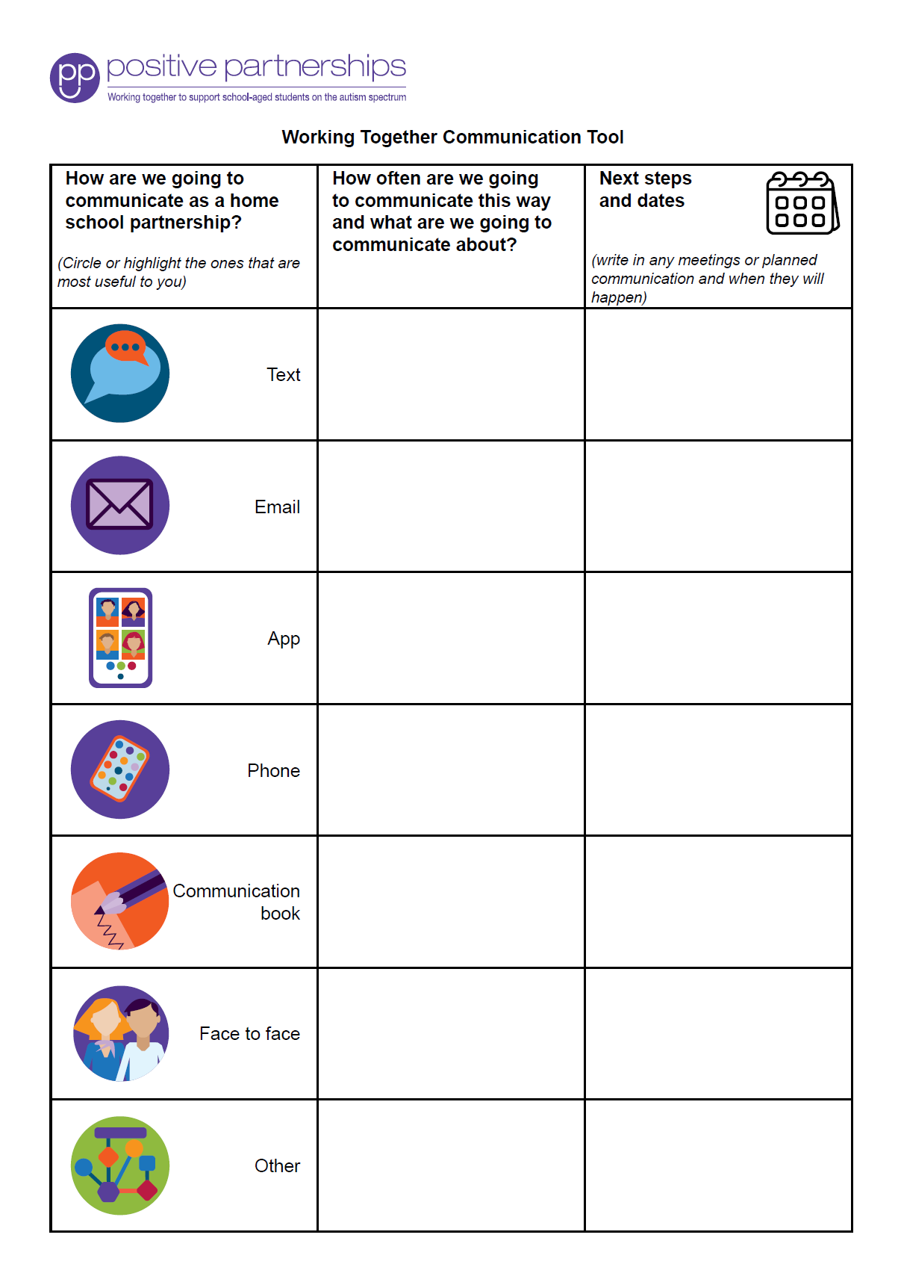
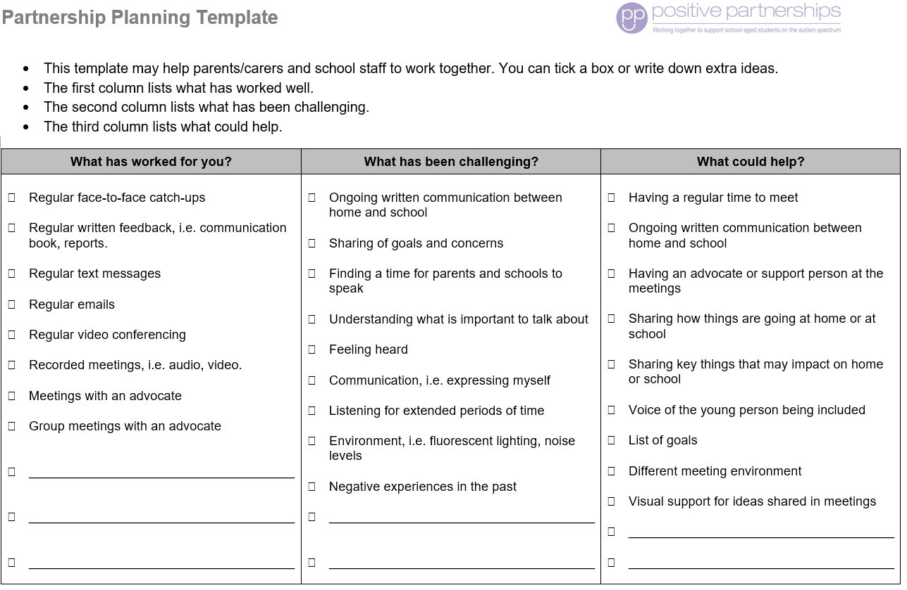
Partnership tools
Notes:
SUGGESTED TIME: 1 min · 1:58 - 1:59
PURPOSE
Show the Partnership tools and how families can use them to prepare for and follow up a school meeting.
WHAT TO DO
1. Show the Partnership tools and briefly explain how each one is used.
2. Frame the tools as supports for consultation, not replacements for listening and your young person's voice.
KEY MESSAGES
• Tools can help a conversation, alongside listening and your young person's voice.

Slide 12
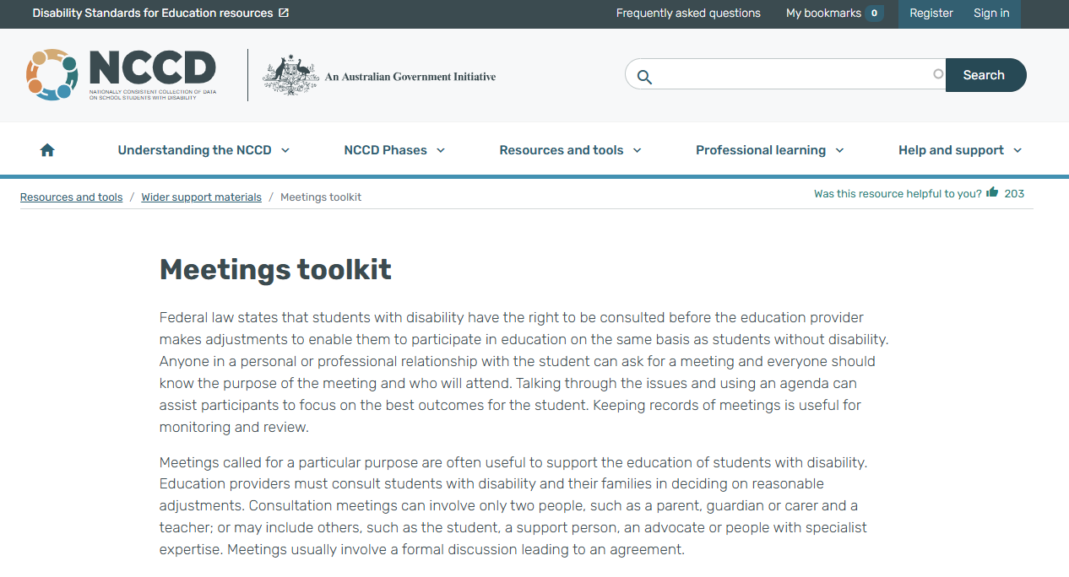
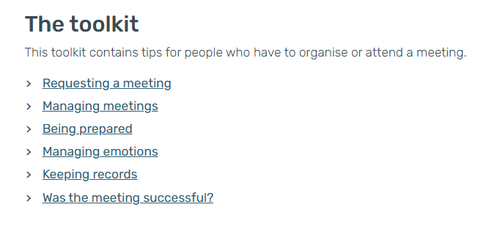
NCCD Meetings Tool Kit
A free tool kit to help families and schools prepare for meetings about adjustments: before, during and after the meeting.
Notes:
SUGGESTED TIME: 1 min · 1:59 - 2:00
PURPOSE
Introduce the NCCD Meetings Tool Kit as a free resource that can make meetings about adjustments clearer.
WHAT TO DO
1. Explain that the Tool Kit helps make the meeting purpose, consultation process, possible adjustments, evidence and next steps clear.
2. Explain that schools follow the processes used in their school or system, and families can ask who is responsible for what and how follow-up will happen.
3. Point families to the Tool Kit on the NCCD website: https://www.nccd.edu.au/wider-support-materials/meetings-toolkit
KEY MESSAGES
• The Tool Kit can help families know what to expect before, during and after a meeting about adjustments.
KEEP IN MIND
• Do not explain NCCD in detail. If asked, talk about levels of adjustment and point to the official NCCD information.
RESOURCES
NCCD Meetings Tool Kit - https://www.nccd.edu.au/wider-support-materials/meetings-toolkit

Slide 13
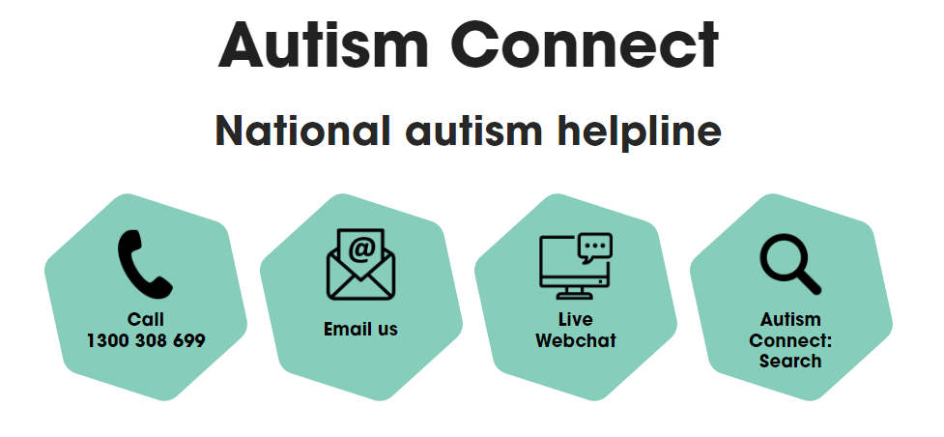


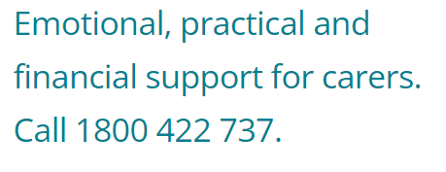

Other practical supports
Youth mental health and crisis support
Kids Helpline 1800 55 1800
Ages 5-25, and parents
headspace.org.au
Ages 12-25
Lifeline 13 11 14
24-hour crisis support
Notes:
SUGGESTED TIME: 1 min · 2:00 - 2:01
PURPOSE
Point families to national helplines and support pathways, including youth mental health and crisis support.
WHAT TO DO
1. Briefly introduce Autism Connect (the national autism helpline), Disability Gateway and Carer Gateway.
2. Note that Carer Gateway offers emotional, practical and financial support for carers.
3. Point out the youth mental health and crisis support lines: Kids Helpline (1800 55 1800, ages 5-25, and parents), headspace (headspace.org.au, ages 12-25) and Lifeline (13 11 14).
4. Leave the slide up so participants can note or photograph the numbers.
KEY MESSAGES
• Help is available beyond today, for your young person and for you.
KEEP IN MIND
• Check phone numbers and services are current before delivery.
RESOURCES
Disability Gateway - 1800 643 787
Carer Gateway - 1800 422 737
Autism Connect national autism helpline - contact details as shown on the slide
Kids Helpline - 1800 55 1800 (ages 5-25, and parents)
headspace - headspace.org.au (ages 12-25)
Lifeline - 13 11 14

Slide 14
Transition planning starts early
Senior years
Subject choices and pathways shape what comes next. Start talking in the middle years.
After school
Further study, training, work and other options. Include your young person in every step.
Who can help
Careers staff, learning support, and disability and employment services.
Notes:
SUGGESTED TIME: 3 min · 2:01 - 2:04
PURPOSE
Encourage families to start thinking about the senior years and life after school early, with their young person included.
WHAT TO DO
1. Walk through the three ideas: senior years, after school, who can help.
2. Explain that subject choices and pathways shape what comes next, so it helps to start talking in the middle years.
3. Name the range of options after school: further study, training, work and other options. Make sure every young person is included, whatever their support needs.
4. Point out that a young person's interests can point the way.
5. Name who can help: careers staff, learning support, and disability and employment services.
YOU MIGHT SAY
You don't need to have it all worked out. Starting early just means more options stay open, and your young person has more time to work out what they want.
KEY MESSAGES
• Start talking about the senior years in the middle years.
• Include your young person in every step.
• Starting early helps keep options open.
KEEP IN MIND
• This topic can bring pressure or worry. Keep it gentle and focused on keeping options open.
• Families of young people with higher support needs should hear their options named with equal respect, including supported employment and community participation.
• Keep to general principles. State-specific pathways and NDIS matters are for the participant pack or specialist services.
THREAD
Interests from Session 4 can point towards study and work.

Slide 15
Prepare for a conversation with school
Prepare for one purposeful conversation.
What needs to be understood?
What question will open the conversation?
How will your young person take part, or have their views included?
What can be decided together?
How and when will we follow up?
Bring these notes to Session 6.
Notes:
SUGGESTED TIME: 6 min · 2:04 - 2:10 · Workbook - Prepare for a conversation with school
PURPOSE
Help each participant prepare for one purposeful conversation with school, to carry into the Session 6 take-home actions.
WHAT TO DO
1. Ask participants to think of a real or likely conversation with school.
2. Invite them to work through the prompts on the slide privately.
3. Encourage short notes rather than a full meeting plan.
4. Ask participants to carry one idea from the power activity into their plan.
5. Encourage participants to think about talking with their young person about the conversation before it happens.
6. Keep sharing optional, particularly where the situation is sensitive.
YOU MIGHT SAY
Bring these notes to Session 6.
KEY MESSAGES
• Prepare for one purposeful conversation.
• A small, specific next step is enough.
ACTIVITY: Private planning · on your own · 6 minutes
Prompt: Prepare for one purposeful conversation.
1. What needs to be understood?
2. What question will open the conversation?
3. How will your young person take part, or have their views included?
4. What can be decided together?
5. How and when will we follow up?
Close: Ask participants to circle the question they will open with and keep these notes for Session 6.
THREAD
Feeds the second of the three small things in Session 6: one thing you would like school to know, understand or support, and the sentence you will open with.

